Slide 1


Russian Market structure
How initiate sales in Russia
Search for local dealers
Best practices in the organization of export into the Russian market
IDEAL METHOD OF ACCESSING THE RUSSIAN
MEDICAL MARKET

Slide 2
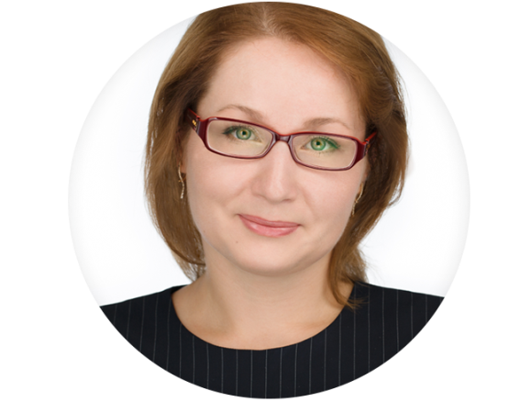



Viktoriya Shmatkova
PhD in Economics
Marketing specialist with more then 20 years experience in medical sector
МВА
Owner and CEO ZERTS
Founder of Medical Consulting Agency D-ZERTS
Founder
of ZERTS school

Slide 3



DEBUNKING THE MYTHS OF SELLING
IN RUSSIA…
Product Certification
with Russian Authorities
The disparity between rules and
real world situations in Russia.
Local partner selection
Background inspection of potential partners in Russia.
How to minimize misunderstanding
with Russian partners?
How to audit cooperation
with Russians?

Slide 4

HOW TO INITIATE WORK
IN RUSSIA?
How to achieve results?

Slide 5


IN YEAR 2017 EXPOCENTRE (RUSSIA)
SET UP YOUR IDEAL TEAM
OF EXPERTS
We offer to you full service for entering the Russian market, we make it streamlined

Slide 6








KEY STAGES
1
2
Market research plan
Medical market evaluation
Permits and certification
3
4
Comparative market analysis
Financial and Cash flow analysis
Business Development strategy
5
6
7
Partner selection
Representative office setup
Translation of Corporate and product advertising material for Russian market
Audit of management and financial activities of local partners
Partners Exchange (if necessary)

Slide 7

HOW WE CAN HELP YOU?
Risk management for market penetration
Pricing and creating market niche
What kind of partners you would require?

Slide 8

KEY MILESTONES
MARKET PENETRATION STRATEGY
Partners efficacy.
One or multi partners cooperation strategy
1
2
Exclusive or non exclusive cooperation with partners
Setting of setup RO office (or not)
3
4
Maintenance and service of medical equipment
Designing pricing strategy
5
6
Business Development strategy
Permission and certification process
7
8
Translation and printing of advertising material

Slide 9


OPTION 1
NON EXCLUSIVE COOPERATION
ASPECTS
Manufacturer to perform self-promotion
Exhibitions, product promotion, catalogues, translation – performed only by manufacturer
Setting of RO office including control, maintenance and service
+
-
Risk diversification
Full control of business in local market
Increased expenditure
Greater risk of financial loss
Significant development effort
HOW TO ACHIEVE SUCCESS?
Setup full operational office
in Russia
SUCCESS STORY:
Mindray (China)
Schmitz (Germany)

Slide 10

OPTION 2
SINGLE PARTNER ON AN EXCLUSIVE BASIS
ZERTS RECOMMENDED
ASPECTS
The partner is responsible for all permission, certification, promotion and business development.
Manufacturer establishes terms and conditions for sales in Russia.
Partner is responsible for all service and maintenance work
+
-
Minimum expenditure for the manufacturer
Partner is responsible for project development
Increased participation at public events at not cost to the manufacturer
Increased of partner failure
Difficult to find a trustworthy partner
HOW TO ACHIEVE SUCCESS?
Meticulous partner selection.
Cooperation agreement created within the legal framework of Russia.
Monitoring and controlling of partner’s activities.
Exchange partner if necessary
SUCCESS STORY:
Carl Zeiss (Germany)
Heinemann (Germany)
Sutter Med (Germany)

Slide 11

BEST PRACTICE METHODS
Conduct market research and development strategy BEFORE entering to local market
Obtain permission and certification by yourself
Take part in exhibitions by own initiative
Perform cooperation with experts
WE REALIZE YOUR AMBITIONS IN RUSSIA

Slide 12

HOW TO BEGIN?
1
2
3
4
Contact us
Get general advice for market entry
Get D-ZERTS support
Select best partner and monitor your partner’s activities

Slide 13





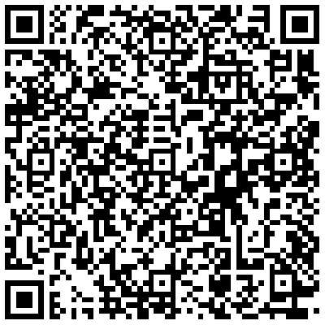

Russia, Moscow
+7 (926) 540-69-45
http://eng.d-zerts.ru
office@zerts.ru
https://shmatkova.viktoria

